Slide 1
Power Transmission Systems
Ramu Rajendran`

Slide 2
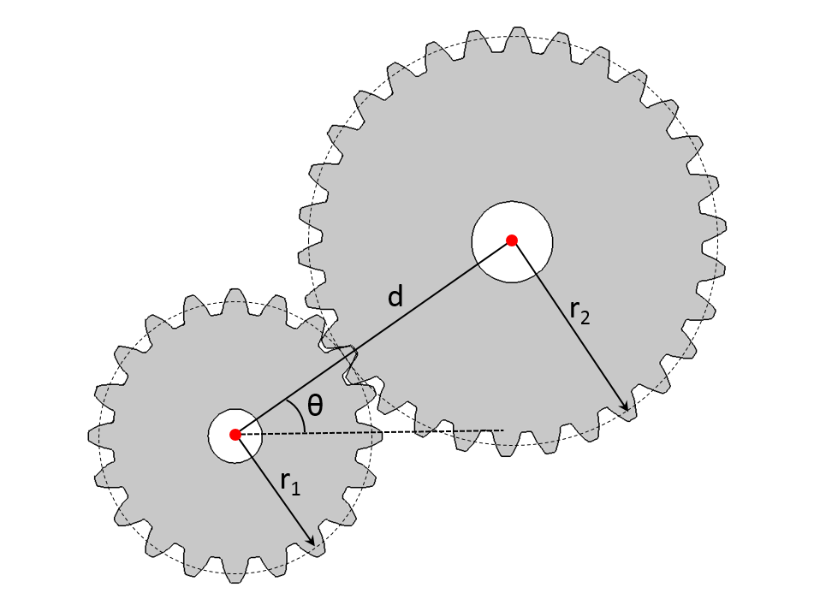
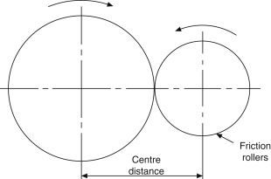

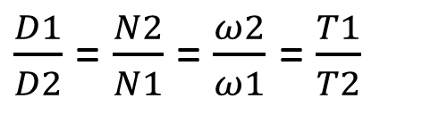
Gears
2
V1 = V2
$\frac{Z1}{Z2}$=
$\frac{D1}{D2}$ = $\frac{N2}{N1}$ = $\frac{ω2}{ω1}$ = $\frac{T1}{T2}$
D = Diameter
N = RPM
ω = Angular Velocity
T = Torque
Z = No: of teeth
1
Gears can be represented in drawings using imaginary pitch circles, working on the principle of friction rollers.

Slide 3
Introduction
Gears are toothed machine elements, used to transmit power between two shafts through rotation motion.
A pair or more gears mesh their teeth to transmit power without slippage.
Gears facilitate transmission of power at variable velocity ratios.

Slide 4
Types of Gears
Spur gears – Teeth cut parallel to the axis of the shaft
Helical gears – Teeth cut an angle to the axis of the shaft
Bevel Gears – Transmit power between intersecting shafts. There are spur bevel gears and helical bevel gears.
Worm Gears – Worm and wheel. Worm drives the wheel.
Rack and pinion – Converting rotary to linear motion and vice versa.

Slide 5
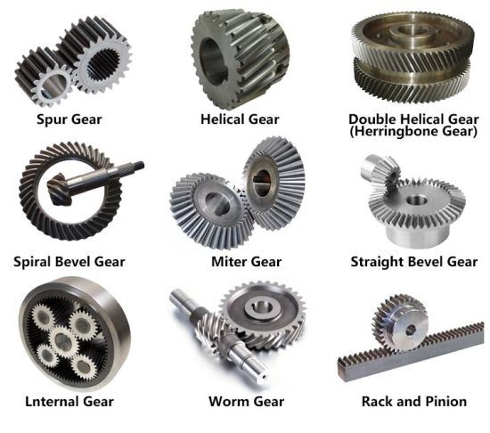

Slide 6
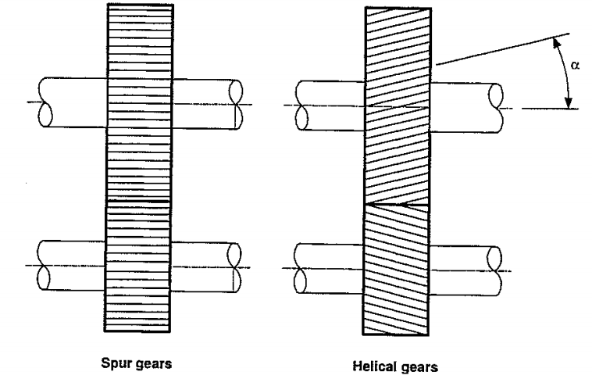
Light load applications as in watches.
Heavier applications as in automobile gear boxes.
A pair of teeth comes in contact all of a sudden. The impact suffered by teeth is large. At high loads teeth breaks easily. Used only for small loads.
Disadvantage of spur gears solved as teeth do not come to contact all of a sudden. Contact and release are gradual. At a time only one point of contact between a pair of teeth and also there are a number of pairs of contacting teeth at a time.

Slide 7
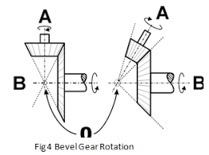
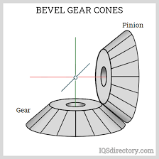
Connecting intersecting shafts. The shafts may or may not be perpendicular. Two types are straight or spur bevel gears and helical bevel gears according to the orientation of teeth with the axis of the shaft. Bevel gears connecting perpendicular shafts and having same size are called Miter gears.
Used in differentials of vehicles.

Slide 8
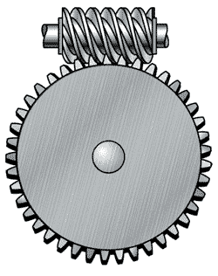
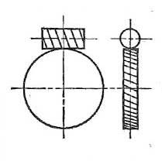
Worm Gears

Slide 9
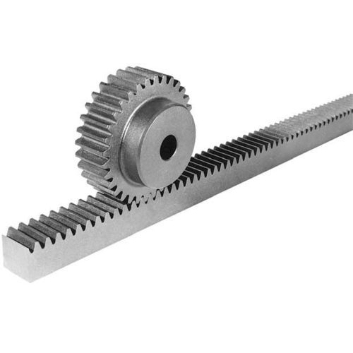
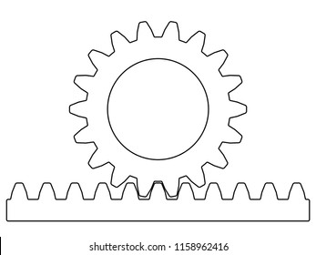
Rack and pinion

Slide 10
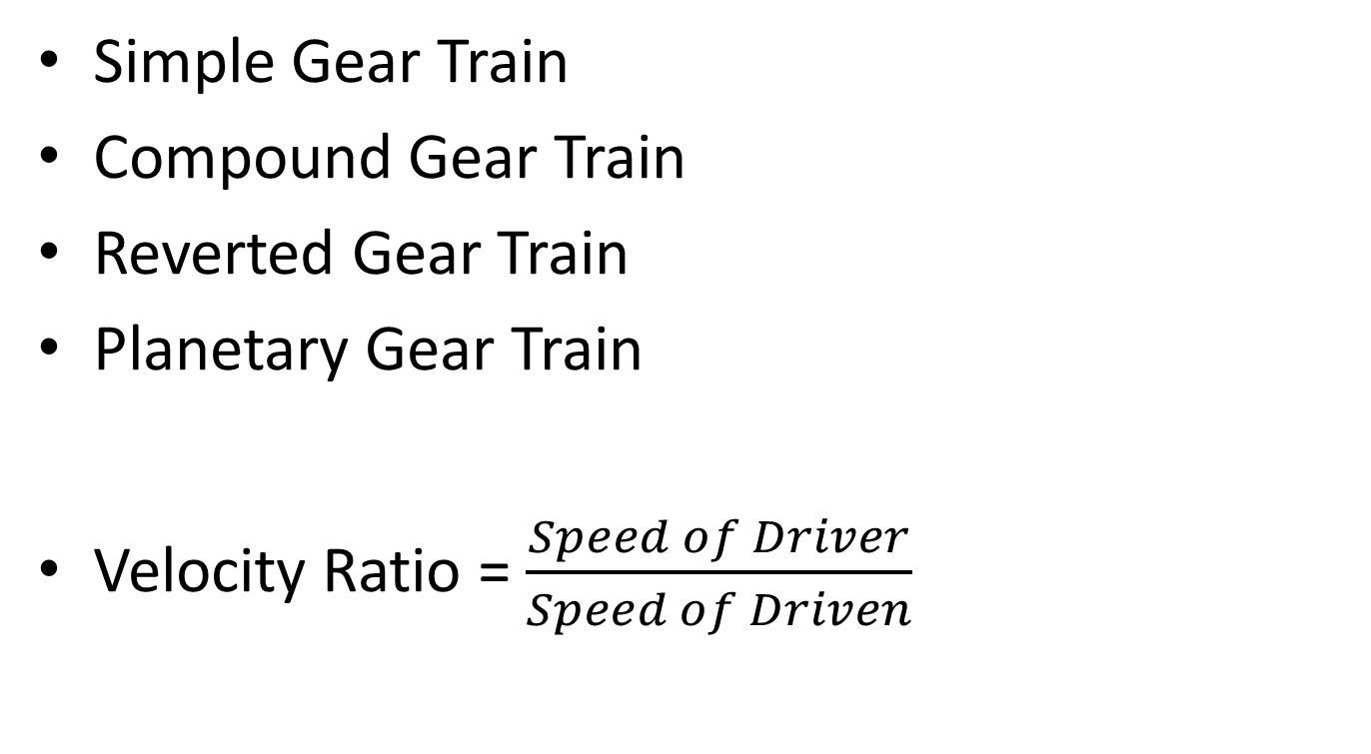
Gear Trains
Simple Gear Train
Compound Gear Train
Reverted Gear Train
Planetary Gear Train
Velocity Ratio = $\frac{Speed of Driver}{Speed of Driven}$

Slide 11
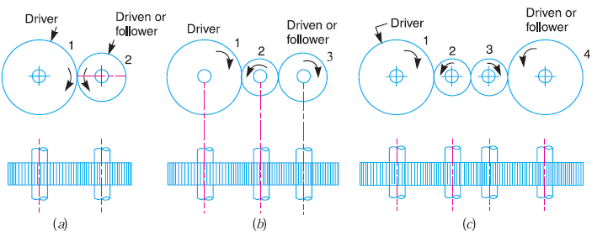
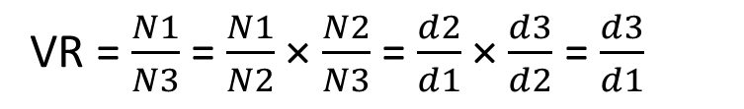
Simple Gear Train
VR = $\frac{N1}{N3}$ = $\frac{N1}{N2}$ × $\frac{N2}{N3}$ = $\frac{d2}{d1}$ × $\frac{d3}{d2}$ = $\frac{d3}{d1}$
Calculation of Velocity ratio for illustration ‘b’.
(Velocity Ratio depends only on the diameters of driven and driven gears. Does not depend on the diameters of intermediate gears.)

Slide 12
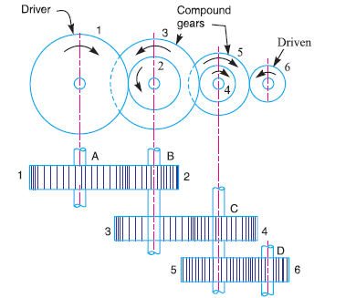
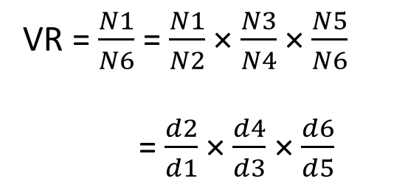
Compound Gear Train
VR = $\frac{N1}{N6}$ = $\frac{N1}{N2}$ × $\frac{N3}{N4}$ × $\frac{N5}{N6}$
= $\frac{d2}{d1}$ × $\frac{d4}{d3}$ × $\frac{d6}{d5}$
(Unlike in the simple gear train, velocity ratio depends on the diameter of the intermediate gears also.)

Slide 13
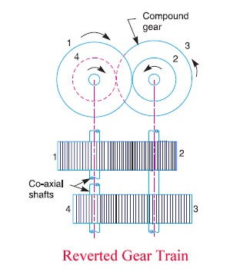

Slide 14
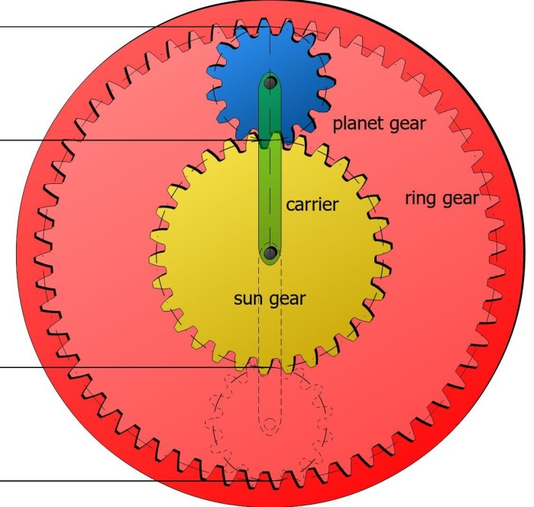
Planetary Gear Train

Slide 15
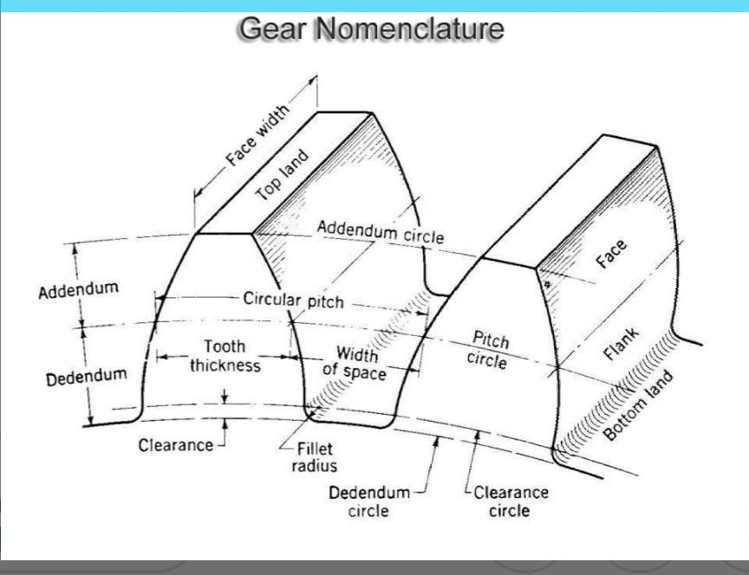

Slide 16
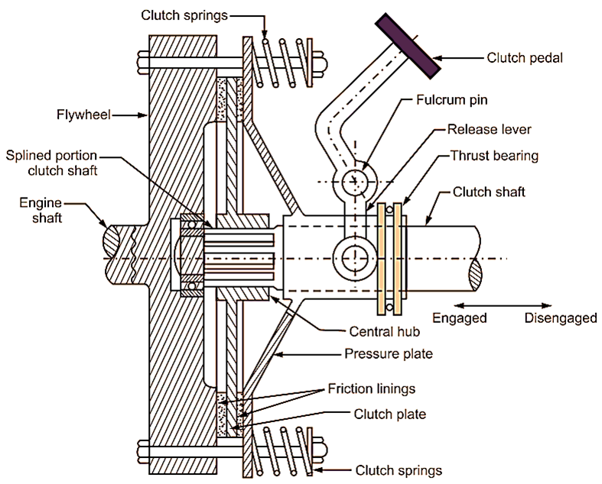
Single Plate Clutch

Slide 17
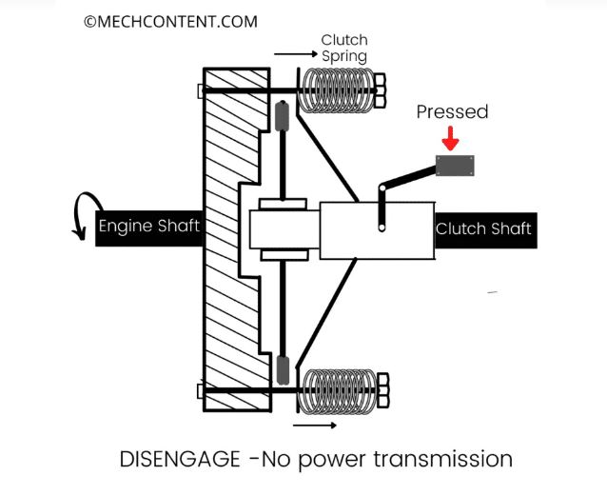

Slide 18
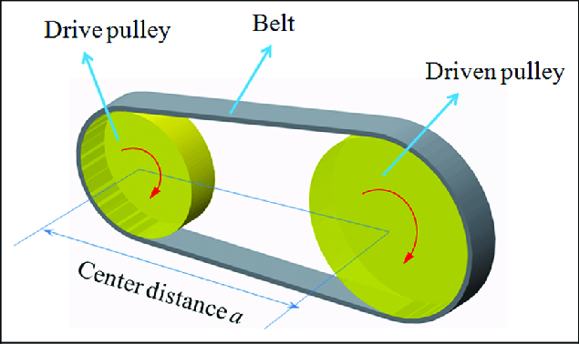
Belt Drive

Slide 19
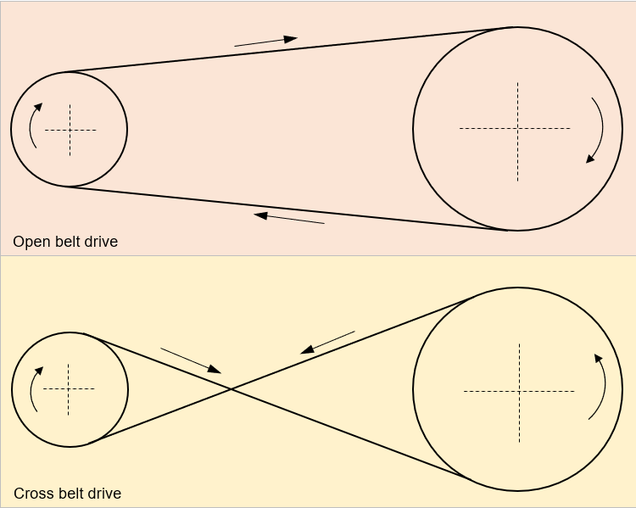

Slide 20
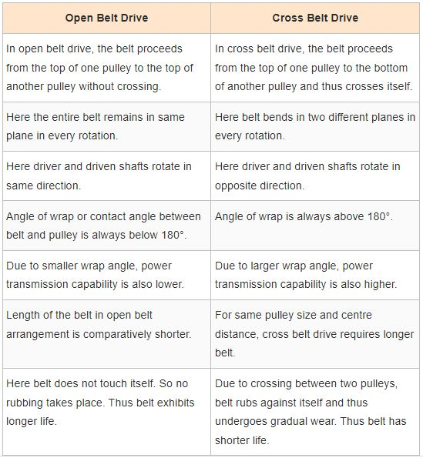

Slide 21
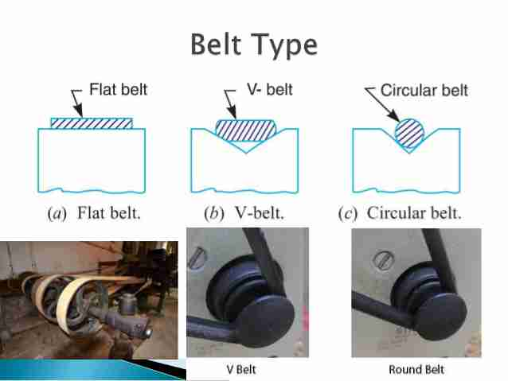
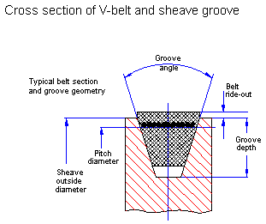

Slide 22
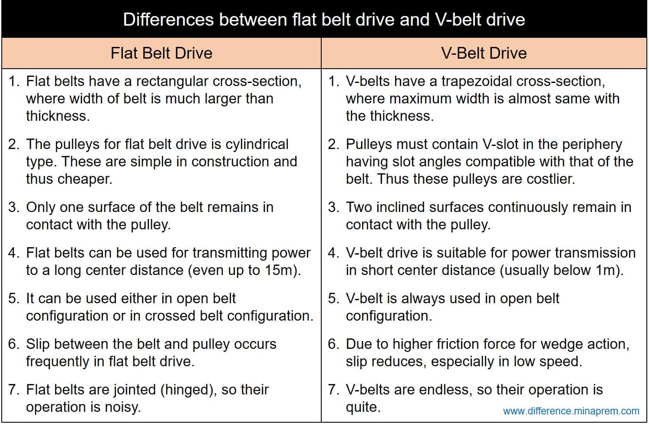

Slide 23
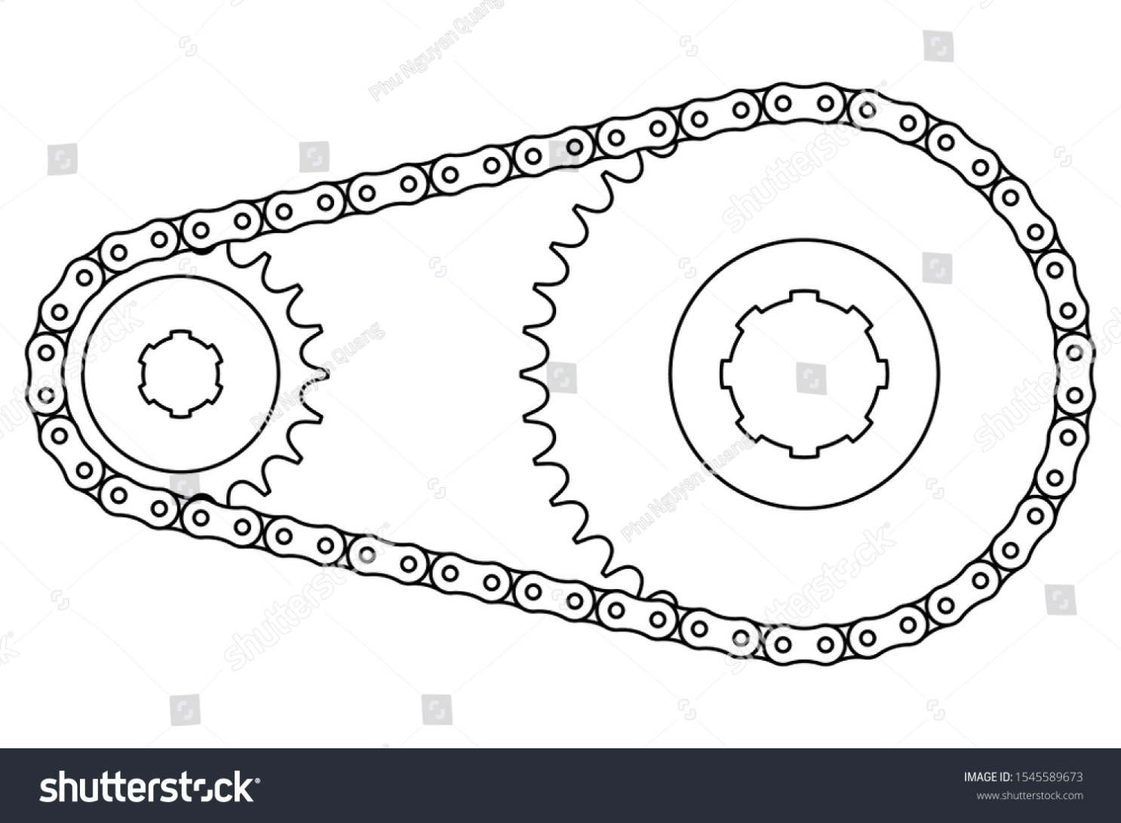
Chain Drives
Roller Chains

Slide 24
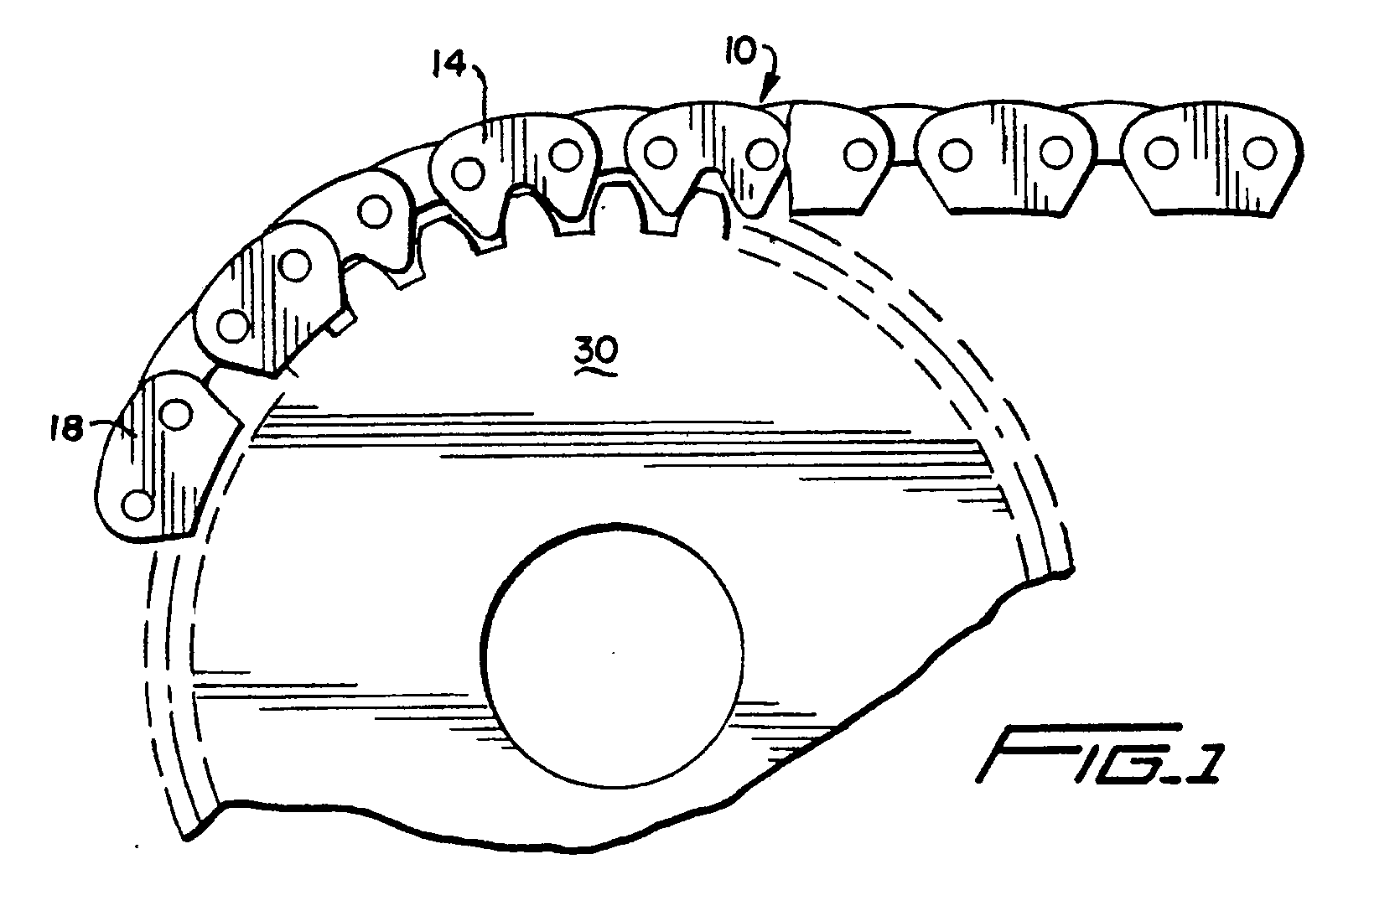
Inverted Tooth Chain

Slide 25
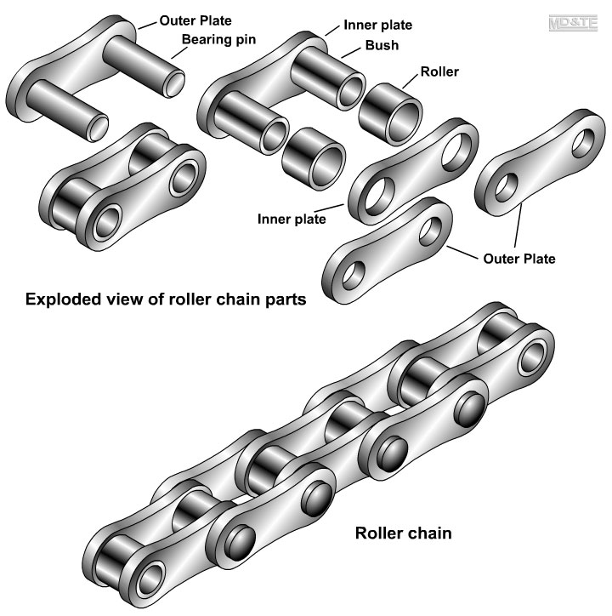
Exploded View

Slide 26
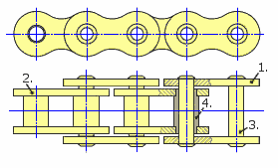
Outer Plate
Inner plate
Bearing Pin
Bush
Roller
Due to the relative motion (ability to move independently) between Pins, Bushes and rollers, the chain acquires its flexibility.

